Slide 1
Chapter 2
Database Environment

Slide 2
Chapter 2 - Objectives
Purpose of three-level database architecture.
Contents of external, conceptual, and internal levels.
Purpose of external/conceptual and conceptual/internal mappings.
Meaning of logical and physical data independence.
Distinction between DDL and DML.
A classification of data models.
Purpose/importance of conceptual modelling.
Typical functions and services a DBMS should provide.

Slide 3
Objectives of Three-Level Architecture
All users should be able to access same data.
A change in a user’s view should not affect other users’ views.
Users should not need to know physical database storage details.

Slide 4
Objectives of Three-Level Architecture
DBA should be able to change database storage structures without affecting the users’ views.
Internal structure of database should be unaffected by changes to physical aspects of storage.
DBA should be able to change conceptual structure of database without affecting all users.

Slide 5
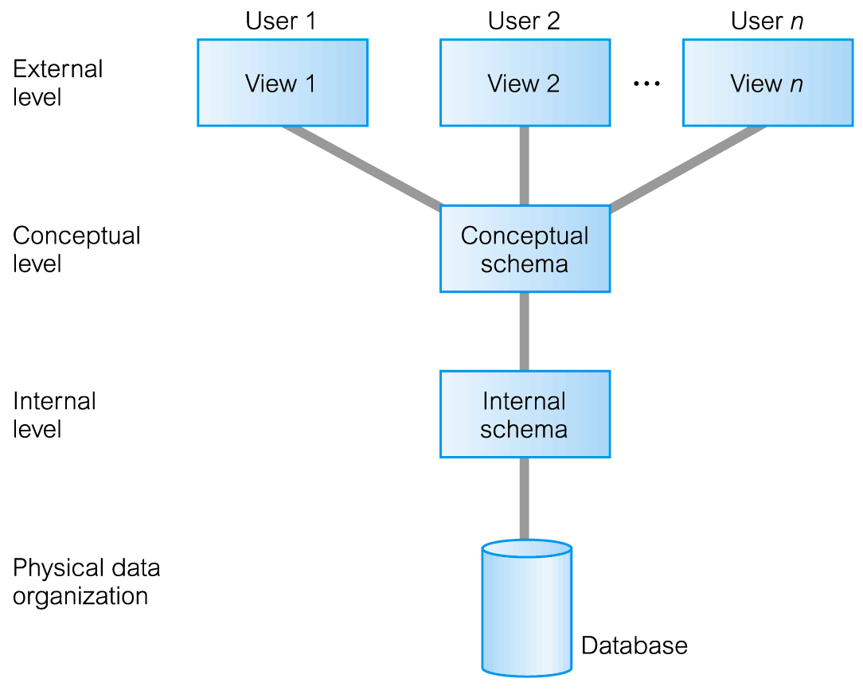
ANSI-SPARC Three-Level Architecture

Slide 6
ANSI-SPARC Three-Level Architecture
External Level
  Users’ view of the database.
  Describes that part of database that is relevant to a particular user.
  The way perceived by end users.
Conceptual Level
  Community view of the database.
  Describes what data is stored in database and relationships among the data.
  The way perceived by the DBA & programmers.

Slide 7
ANSI-SPARC Three-Level Architecture
Internal Level
  Physical representation of the database on the computer.
  Describes how the data is stored in the database.
  The way perceived by the DBMS & OS.

Slide 8
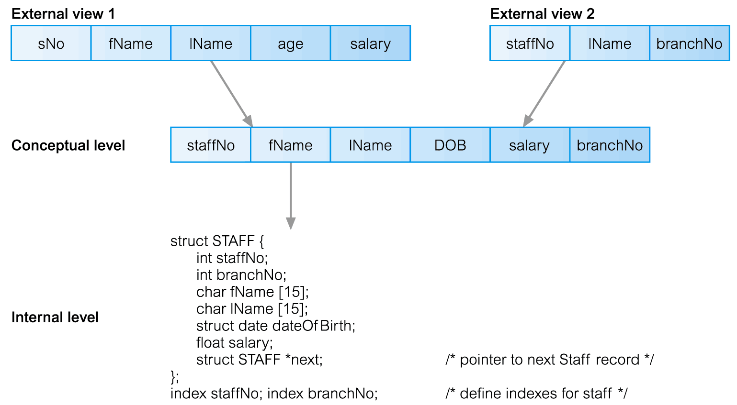
Differences between Three Levels

Slide 9
Schemas versus Instances
Database Schema: The description of the database. It rarely changes.
  Includes descriptions of the database structure, data types, and the constraints on the database.
Database Instance (snapshot): The actual data stored in a database at a particular moment in time. Changes rapidly.
The concepts of Schema & Instances corresponds to Types & Values in programming languages, respectively.

Slide 10
Schemas, Mappings, and Instances
Mapping is the process of transforming requests and results between the Internal, Conceptual & External levels.
  Programs refer to an external schema, and are mapped by the DBMS to the internal schema for execution.
  Data extracted from the internal DBMS level is reformatted to match the user’s external view.
Two types of mapping:
– External / Conceptual mapping.
– Conceptual / Internal mapping.

Slide 11


Example
    Schema
Instance

Slide 12
Data Independence
Logical Data Independence
  Refers to immunity of external schemas to changes in conceptual schema.
  Conceptual schema changes (e.g. addition/removal of entities).
  Should not require changes to external schema or rewrites of application programs.

Slide 13
Data Independence
Physical Data Independence
  Refers to immunity of conceptual schema to changes in the internal schema.
  Internal schema changes (e.g. using different file organizations, storage structures/devices).
  Should not require change to conceptual or external schemas.

Slide 14
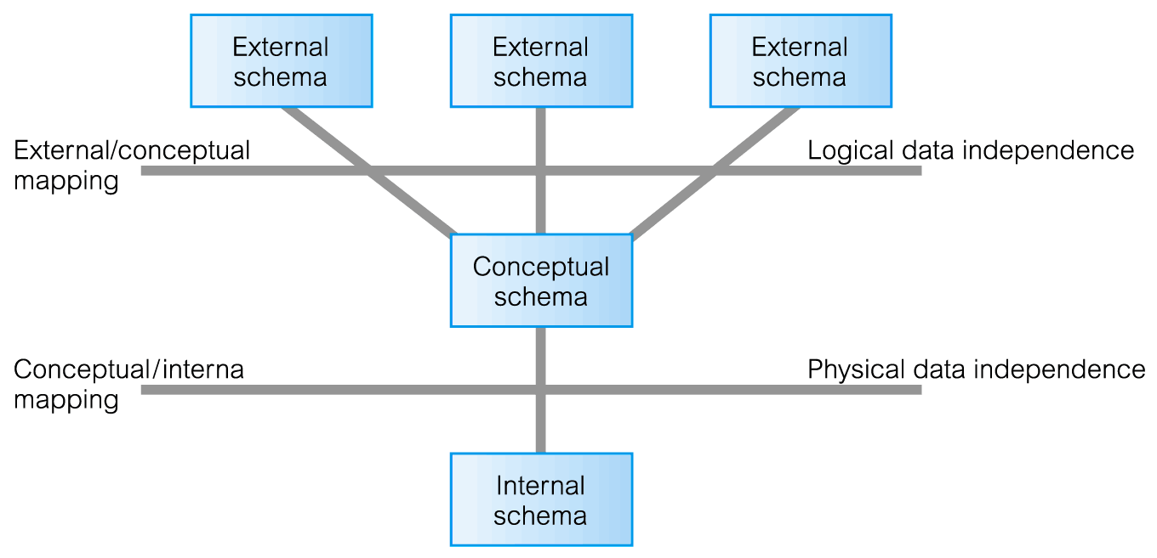
Data Independence and the ANSI-SPARC Three-Level Architecture

Slide 15
Database Languages
Data Definition Language (DDL)
  Allows the DBA or user to describe and name entities, attributes, and relationships required for the application together with any associated integrity and security constraints.
  DDL is a descriptive language for defining and constructing the database.
  Allows users to specify the data types and structures and the constraints on the data to be stored in the DB.
  DDL compiler generates the meta-data that is stored in the data dictionary.

Slide 16
Database Languages
Data Manipulation Language (DML)
  Provides basic data manipulation operations on data held in the database.
  DML is a language for retrieving and updating (insert, delete, & modify) the data in the DB.
  Types of DML:
  Procedural Language (3GL): user specifies what data is required and how to get those data(allows user to tell system exactly how to manipulate data.) Ex:Java
  Nonprocedural Language(4GL): user specifies what data is required without specifying how to get those data(allows user to state what data is needed rather than how it is to be retrieved.) Ex:SQL

Slide 17
Database Languages
Both DDL and DML are usually not considered distinct languages. Rather, they are included in a comprehensive integrated language.
For example, SQL relational database language is a comprehensive DB language which represents a combination of DDL and DML.

Slide 18
Database Languages
DBMS have a facility for embedding DDL & DML (sub-languages) in a High-Level Language (COBOL, C, C++ or Java), which in this case is considered a host language
C,C++,Lisp,..
Application Program
Call to DB
DBMS
Local Vars
(memory)

Slide 19
Data Model
Integrated collection of concepts for describing data, relationships between data, and constraints on the data in an organization.
  To represent data in an understandable way.
Data Model comprises:
  a structural part;
  a manipulative part;
  possibly a set of integrity rules.

Slide 20
Categories of Data Models
Conceptual data models (Object-based): is the construction of an enterprise’s information that is independent of implementation details.
  Also called entity-based or object-based data models.
Logical data models (Record_based): is the logical description of an enterprise’s information with high level description of the implementation.
    Also called record-based data models.
Physical data models: is the physical description of how data is stored in the computer.

Slide 21
Categories of Data Models
Hardware independent
Software independent
Conceptual
model
Hardware independent
Software dependent
Logical
model
Hardware dependent
Software dependent
Physical
model

Slide 22
Data Models
Conceptual data models (Object-based):
  Entity-Relationship
  Semantic
  Functional
  Object-Oriented
Logical data models (Record_based):
  Relational Data Model
  Network Data Model
  Hierarchical Data Model
Physical Data Models

Slide 23
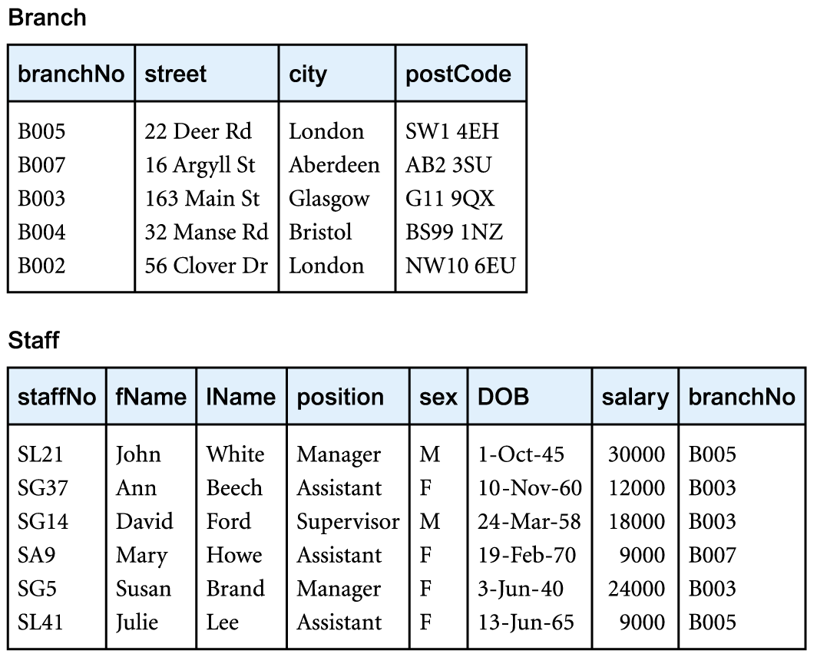
Record-Based Data Models
Relational Data Model

Slide 24
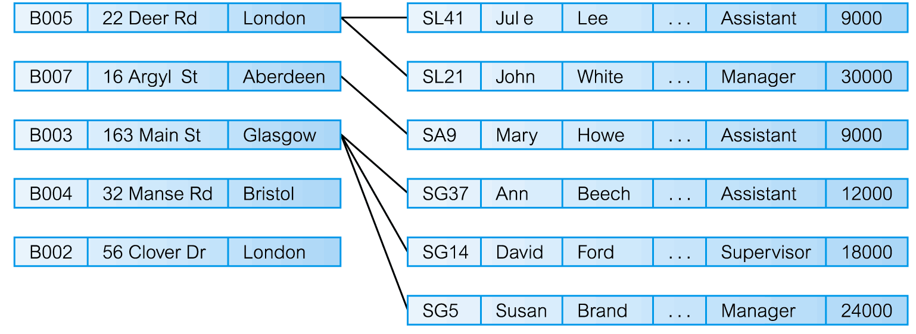
Record-Based Data Models
Network Data Model

Slide 25
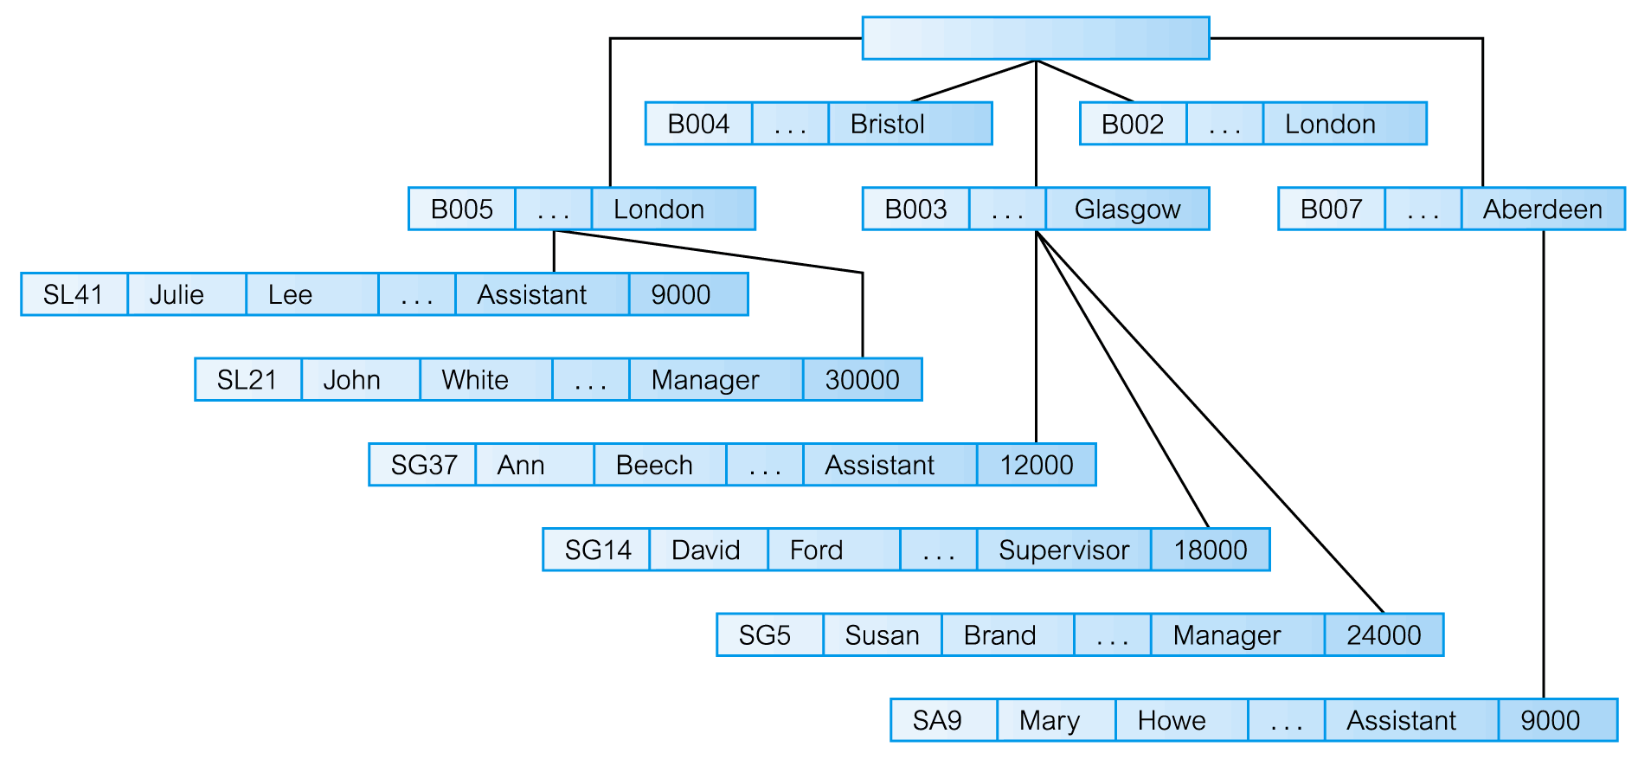
Record-Based Data Models
Hierarchical Data Model

Slide 26
Functions of a DBMS
Data Storage, Retrieval, and Update.
A User-Accessible Catalog.
Transaction Support.
Concurrency Control Services.
Recovery Services.

Slide 27
Functions of a DBMS
Authorization Services.
Support for Data Communication.
Integrity Services.
Services to Promote Data Independence.
Utility Services.

